Slide 1
Share Menu
Brenda Puvirajasinghe

Slide 2
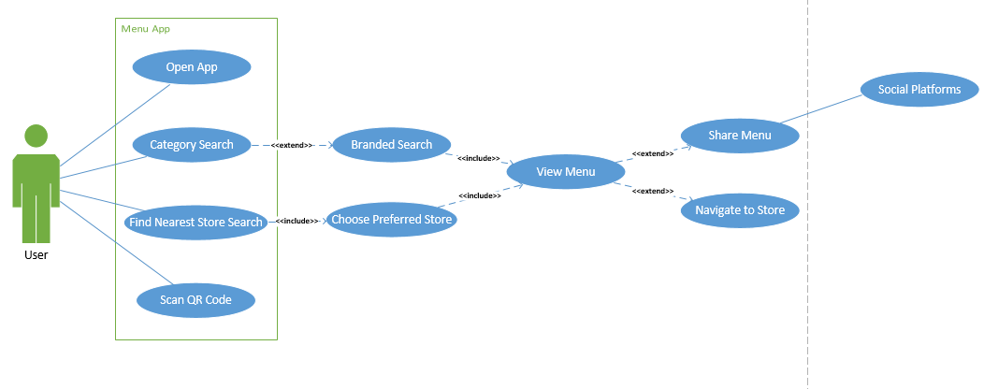
Use case diagram

Slide 3
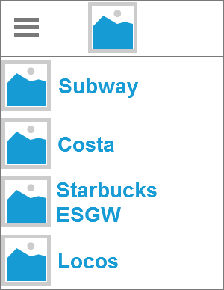
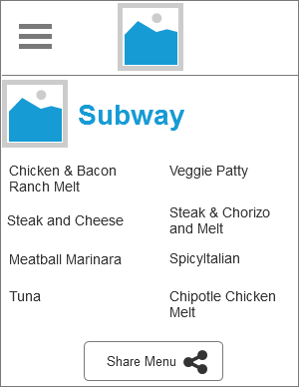
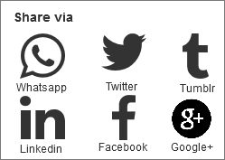
Share menu design using axure rp 8

Slide 4
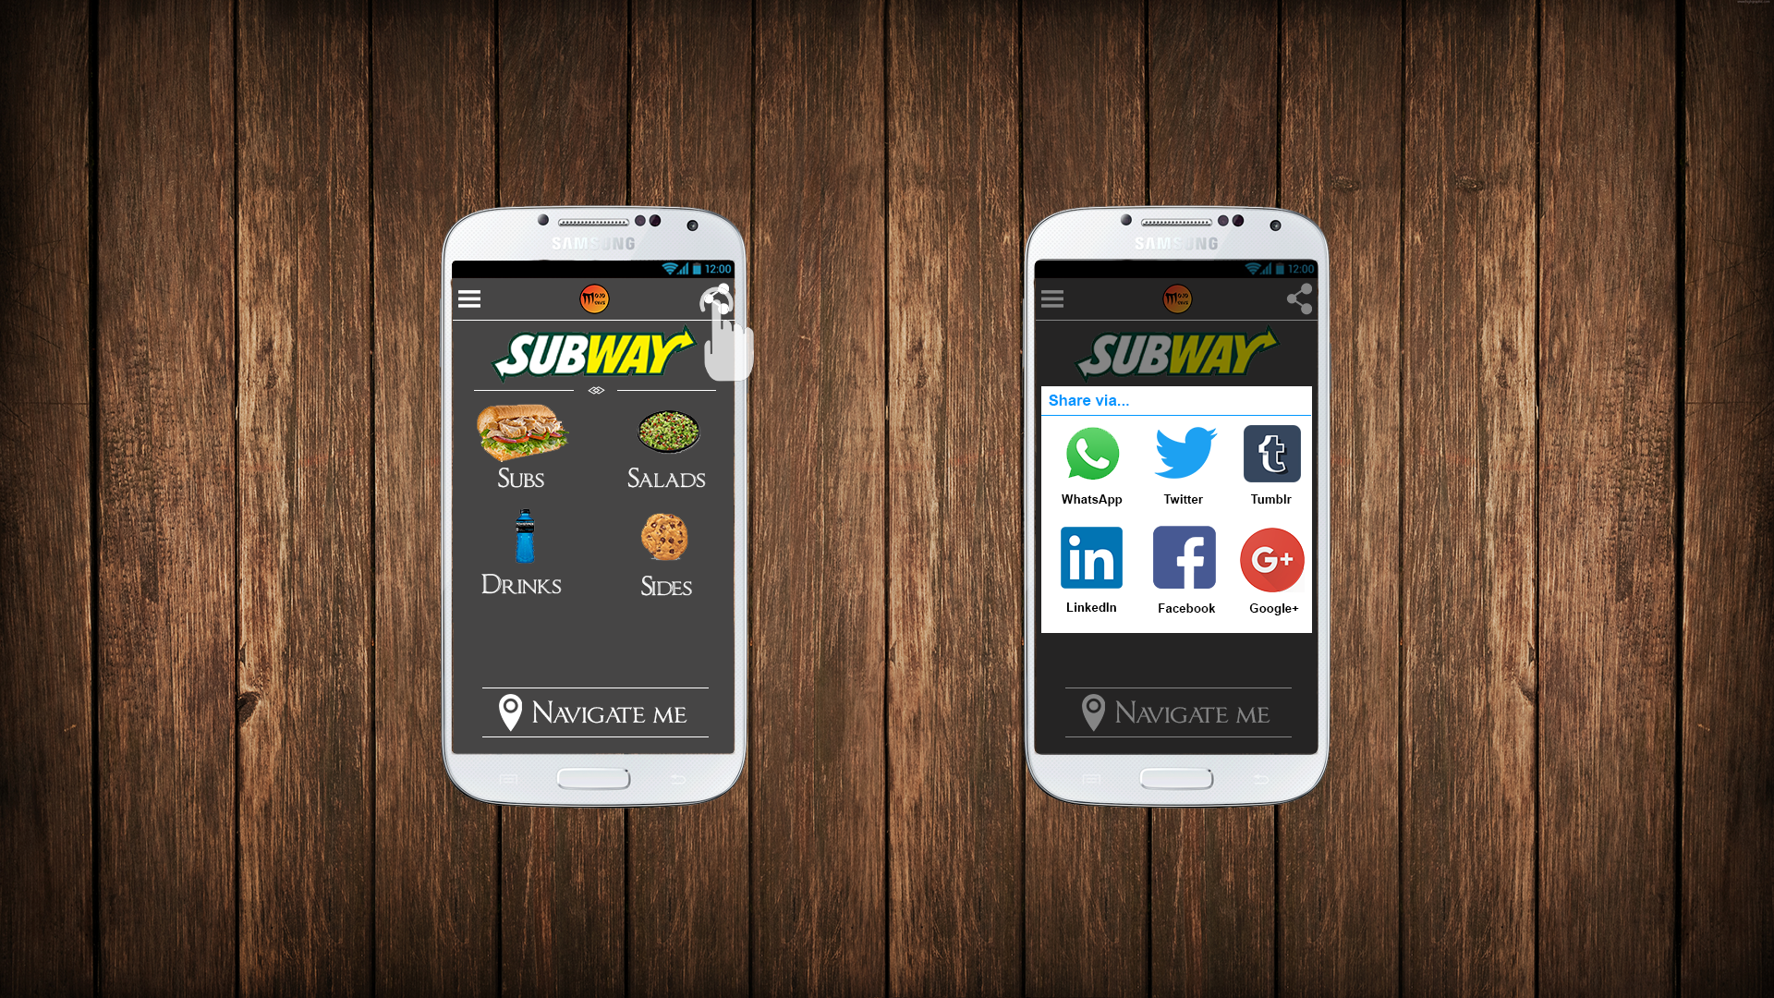
Share menu
E.g. Subway
Menu presented
Share button
Pop up window
Various platforms
Menu shared

